Slide 1

AP Economics
Decisions, Decisions, Decisions
Mr. Gill
12:04- 12:44
256-4175 ext. 69522
jgill@newpaltz.k12.ny.us

Slide 2

What is Economics?
Science of Decisions- Incentives, Marginal Analysis
Why must decisions be made?

Slide 3

Scarcity!
Unlimited Needs + Limited Resources

Slide 4
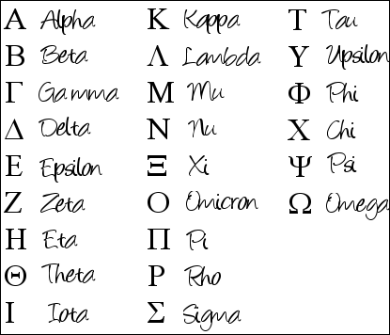
Learning the Language
Scarcity
4 Basic Questions
Trade Offs and Opportunity Costs
Costs and Incentives
Positive and Normative Economics
Factors of Production
The PPF- Production Possibilities Frontier
Economic Needs and Wants

Slide 5
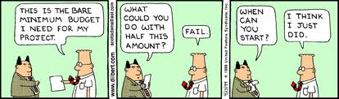
The Four Basic Questions
What to Produce?
How to Produce?
How much to Produce?
How to Distribute?

Slide 6
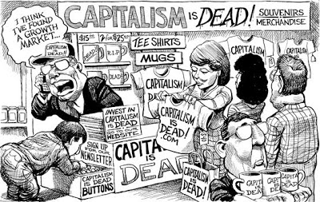
Types of
Economics
Economic Systems
Normative
Positive
Macroeconomics
Microeconomics
Free Enterprise
Command

Slide 7

Trade Off
What is given up when making a decision.

Slide 8

Opportunity Costs
The value of the next best alternative given up in a trade off.
I could be…

